Slide 1
DATA MINING
Sentiment Analysis LSTM Algorithm
Ray Jonathan - 1121027

Slide 2
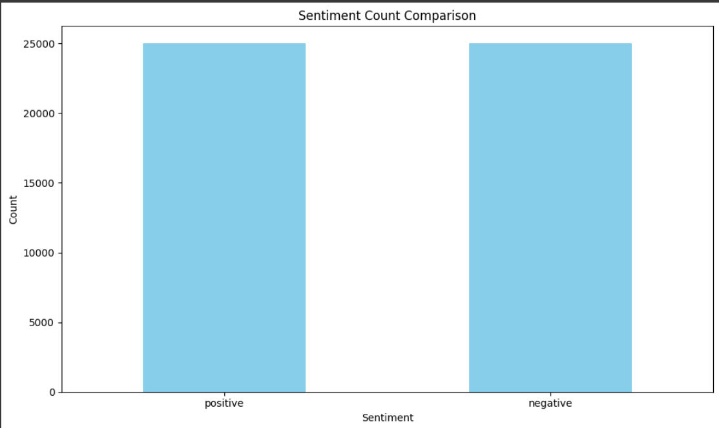
EDA
Dataset : Internet Movie Database (IMDb) Review
Count : 50.000 Data
2 Features : review, sentiment
Sentiment : Positive, Negative
Positive : 25.000
Negative : 25.000
Ray Jonathan - 1121027

Slide 3
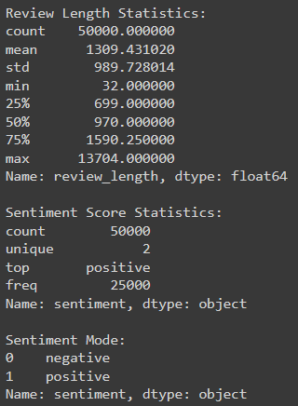
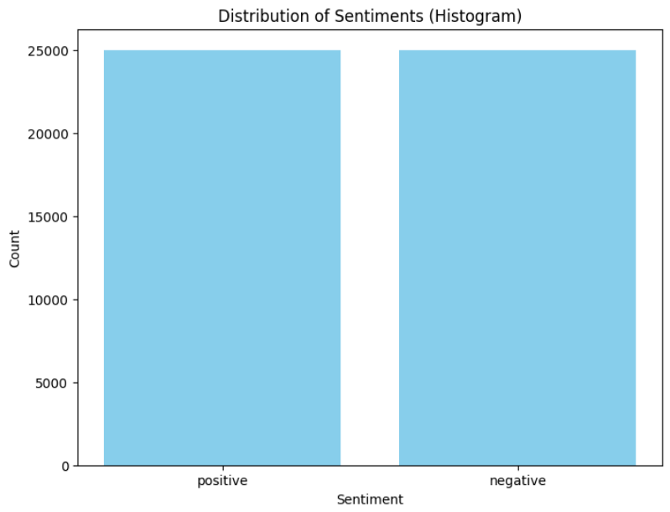
EDA
Dataset : Internet Movie Database (IMDb) Review
Distribution of Sentiments
2. Distribution of Sentiments
Ray Jonathan - 1121027

Slide 4
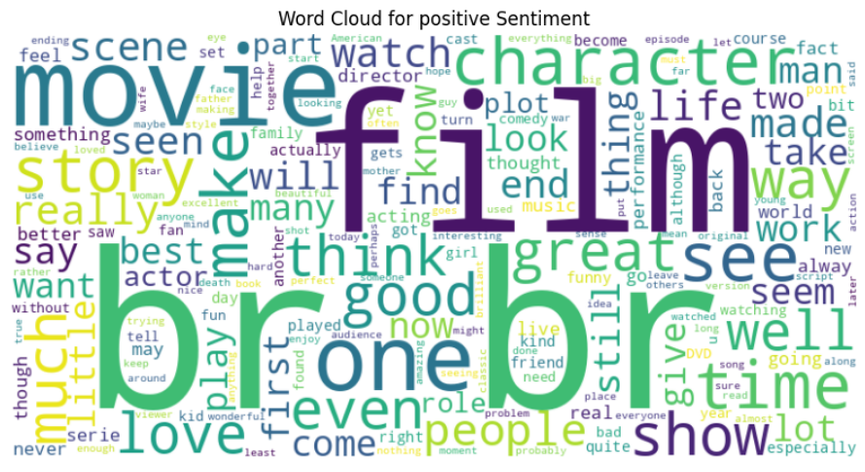
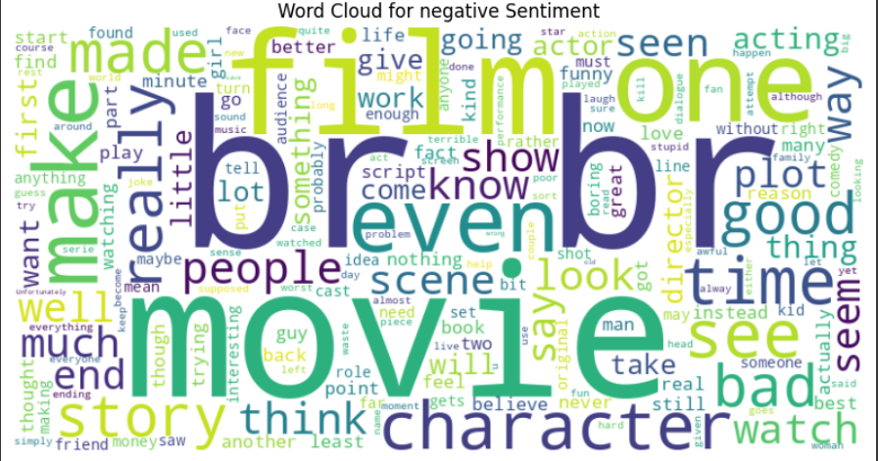
EDA
Dataset : Internet Movie Database (IMDb) Review
3. Word Cloud
Ray Jonathan - 1121027

Slide 5
EDA
Dataset : Internet Movie Database (IMDb) Review
3. Word Cloud
Ray Jonathan - 1121027

Slide 6
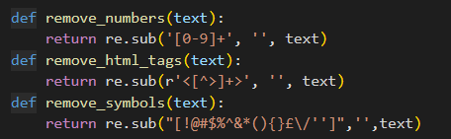

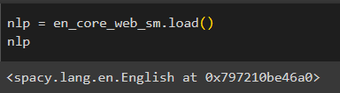

PREPROCESSING
Ray Jonathan - 1121027

Slide 7
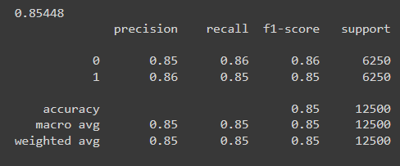
ACCURACY SCORE
Ray Jonathan - 1121027

Slide 8
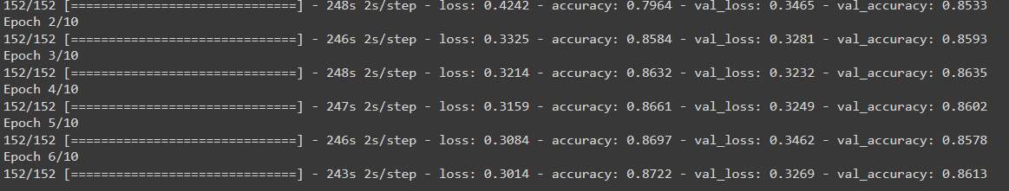
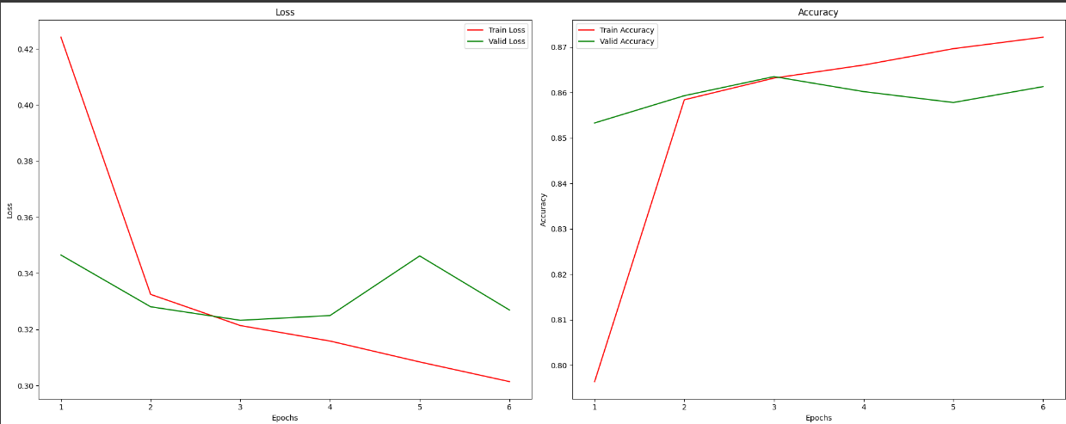
Training Data
EPOCH = 10
Ray Jonathan - 1121027

Slide 9
Thankyou
Ray Jonathan - 1121027

